Slide 1


Slide 2
Inductive Logical Reasoning
Problem Statement: You will be show a few figures your job, is to mark image/images that will fit the rule logically.

Slide 3
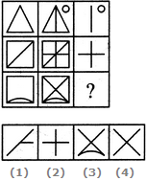
Directions to Solve : In each of the following questions, find out which of the answer figures (1), (2), (3) and (4) completes the figure matrix ?
1. Select a suitable figure from the four alternatives that would complete the figure matrix.
Options :
1
2
3
4

Slide 4
Answer: Option D
Explanation:
The third figure in each row comprises of parts which are not common to the first two figures.

Slide 5
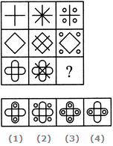
2. Select a suitable figure from the four alternatives that would complete the figure matrix.
Options :
1
2
3
4

Slide 6
Answer: Option B
Explanation:
In each row, the second figure is obtained from the first figure by adding two mutually perpendicular line segments at the centre and the third figure is obtained from the first figure by adding four circles outside the main figure.

Slide 7
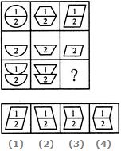
3. Select a suitable figure from the four alternatives that would complete the figure matrix.
Options :
1
2
3
4

Slide 8
Answer: Option C
Explanation:
In each column, the second figure (middle figure) is obtained by removing the upper part of the first figure (uppermost figure) and the third figure (lowermost figure) is obtained by vertically inverting the upper part of the first figure.

Slide 9
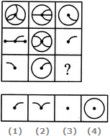
4. Select a suitable figure from the four alternatives that would complete the figure matrix.
Options :
1
2
3
4

Slide 10
Answer: Option C
Explanation:
The third figure in each row comprises of the parts common to the first two figures.

Slide 11
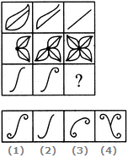
5. Select a suitable figure from the four alternatives that would complete the figure matrix.
Options :
1
2
3
4

Slide 12
Answer: Option A
Explanation:
The number of components in each row either increases or decreases from left to right. In the third row, it increases.

Slide 13
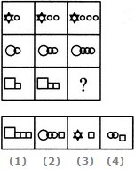
6. Select a suitable figure from the four alternatives that would complete the figure matrix.
Options :
1
2
3
4

Slide 14
Answer: Option A
Explanation:
In each row, the second figure is obtained from the first figure by increasing the number of smaller elements by one and the third figure is obtained from the second figure by increasing the number of smaller elements by one.

Slide 15
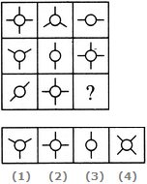
7.. Select a suitable figure from the four alternatives that would complete the figure matrix.
Options :
1
2
3
4

Slide 16
Answer: Option A
Explanation:
Each row (as well as each column) contains a figure consisting of a circle and two line segments, a figure consisting of a circle and three line segments and a figure consisting of a circle and four line segments.

Slide 17
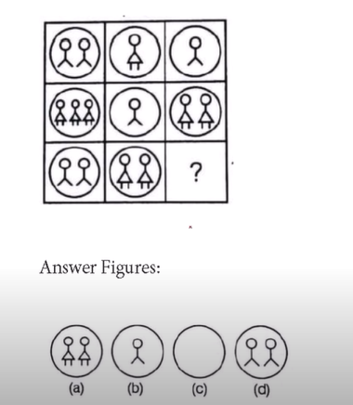

Slide 18
Ans c

Slide 19
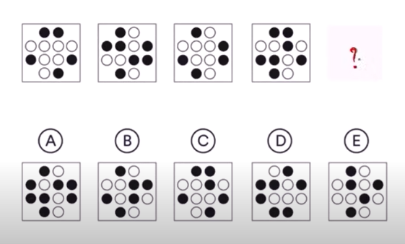

Slide 20
Ans e

Slide 21

You will be shown a few figures your job, is to mark image/images that don’t fit the rule logically
.

Slide 22
You will be shown a few figures your job, is to mark image/images that don’t fit the rule logically
Ans fig e

Slide 23

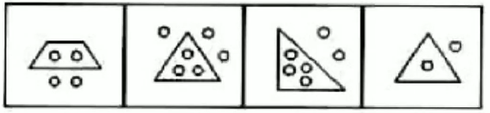
Q. 33
A B C D
Ans. C

Slide 24
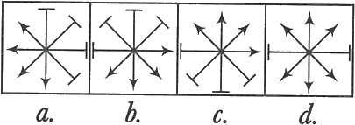
Ans. d

Slide 25
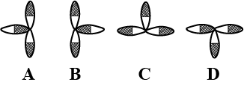
Ans. C

Slide 26
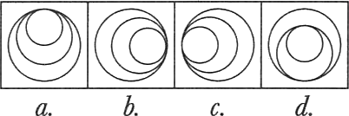
Ans. d

Slide 27
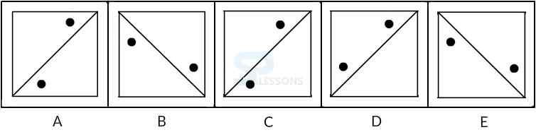
Ans. D

Slide 28
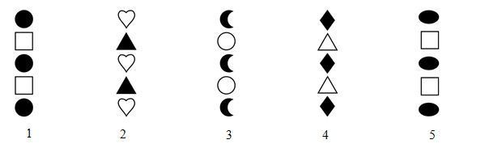
Ans. 2

Slide 29
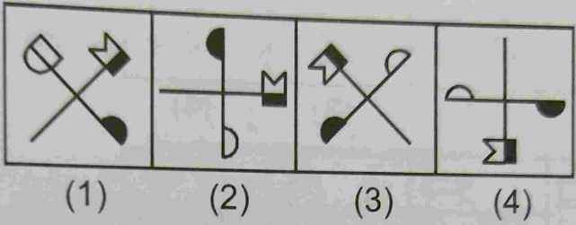
Ans. 1

Slide 30
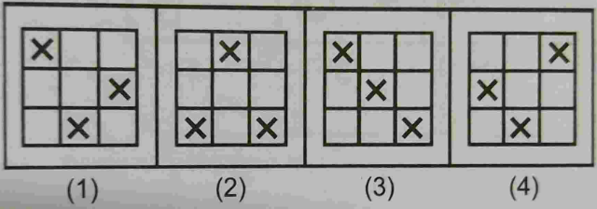
Ans. 2

Slide 31
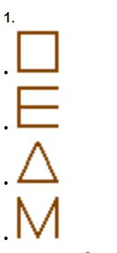

Slide 32
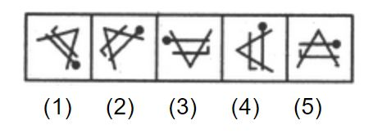

Slide 33
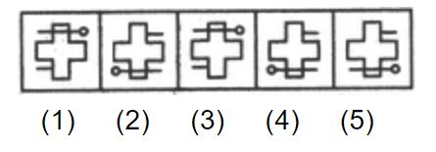

Slide 34
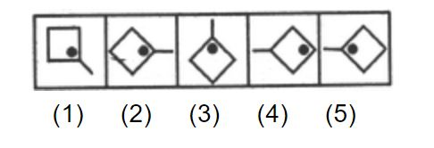

Slide 35
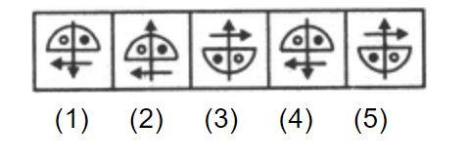

Slide 36
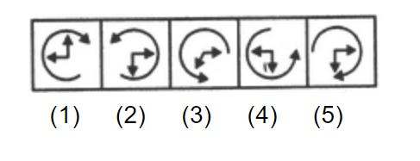

Slide 37
